Slide 1
CS 97 Discussion 1B
Week 7
TA Howard Xie

Slide 2
Announcements
Midterm grades are released - regrade requests close Monday
Assignment 5 (C language) due Sunday 11/22 at 23:55
Assignment 6 is about Git commits as Directed Acyclic Graphs and is due early Week 10

Slide 3
Today’s Agenda
Poll
Write and malloc system calls in C for Assignment 5
Data storage in Git for Assignment 6

Slide 4
System Calls for Assignment 5
For output option -o to output N KiB at a time, use malloc and write
void *malloc(size_t size);
The malloc() function allocates size bytes and returns a pointer to the allocated memory.
void free(void *ptr);
The free() function frees the memory space pointed to by ptr, which must have been returned by a previous call to malloc(), calloc(), or realloc().
ssize_t write(int fd, const void *buf, size_t count);
write() writes up to count bytes from the buffer starting at buf to the file referred to by the file descriptor fd.
On success, the number of bytes written is returned. On error, -1 is returned, and errno is set to indicate the cause of the error.

Slide 5
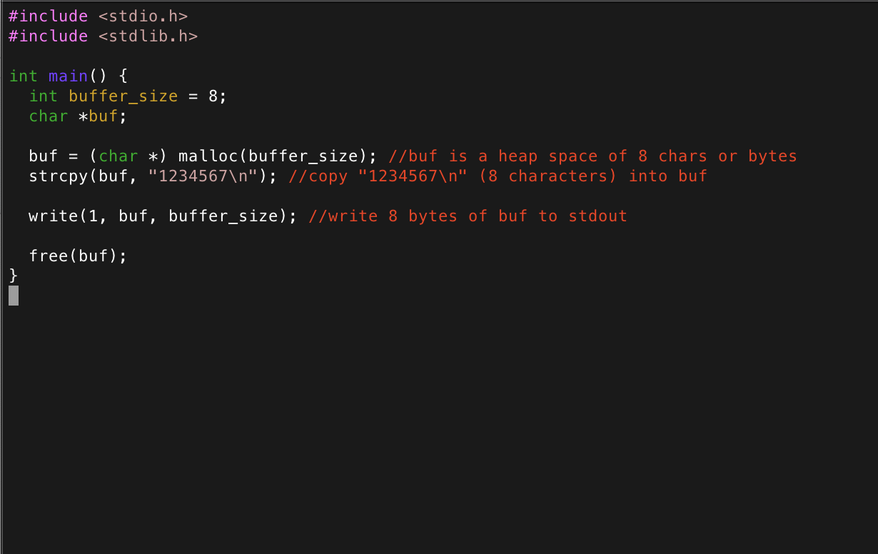
Demo
Demonstration of malloc, write, and free system calls.

Slide 6
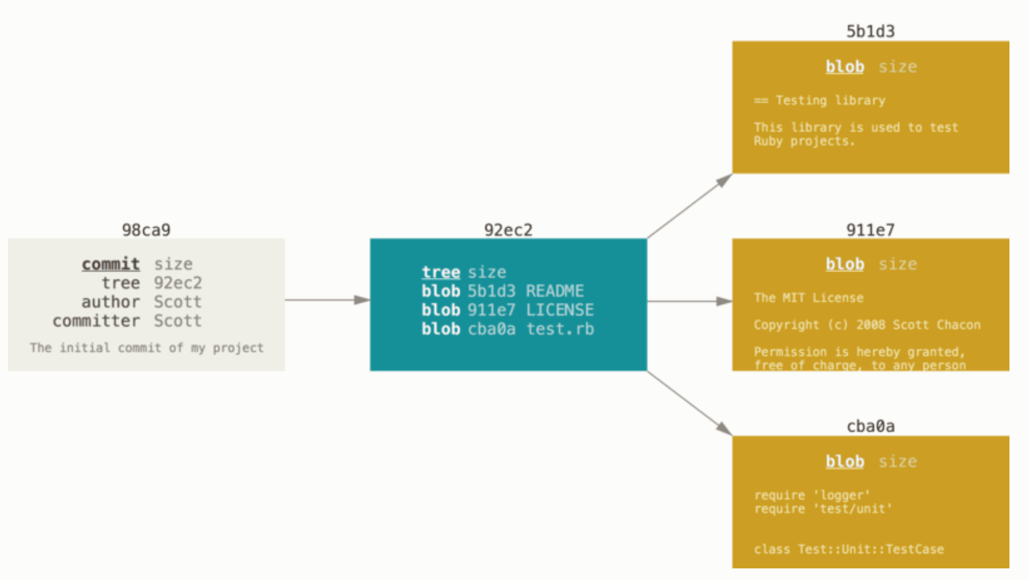
Data Storage in Git
Under the hood of Git, how are files stored?
There are three types of “Objects” in Git
Commit object - contains info on the commit, a pointer to the relevant tree
Tree - can think of as a folder
Blob - can think of as a file

Slide 7
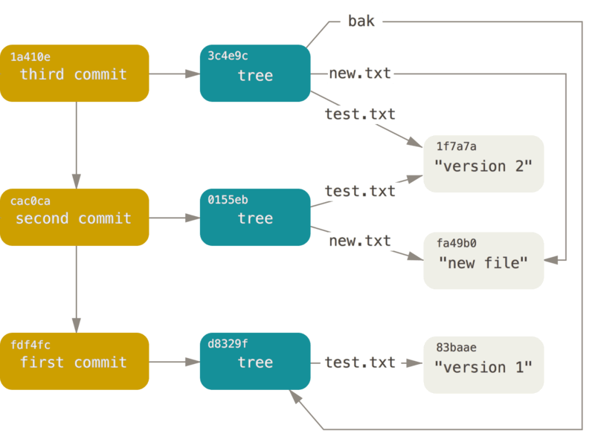
Example
First commit points to a tree that points to one file - “test.txt”
Second commit points to another tree that points to a new version of “test.txt” and a new file called “new.txt”
Third commit points to another tree that points to the same two files as before, plus a new folder called “bak” that contains version 1 of “test.txt”

Slide 8
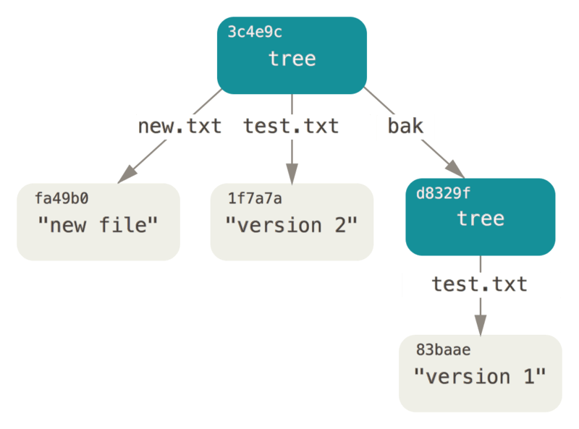
A Clearer Image of the Third Commit

Slide 9
Demo
Demonstration of where Git objects are held.

Slide 10
Worksheet
Time for the worksheet

